Slide 1
Trujillo Trail DWID
State of Things

Slide 2
Agenda
Formation of Trujillo Trail DWID (“TTDWID”) and Area
Elections
Loans
Pipeline Update
Water System
Lead and Copper and Drinking Water Quality & Rules
Future projects

Slide 3
Formation of TTDWID
June 15, 2021
TTDWID is public body
TTDWID formed to be able to obtain loans from WIFA with low interest rates and forgivable principal
  WIFA has State money and U.S. money
  WIFA funds up to $50K for State recognized engineering firms for project
  Davis Bacon and US Iron and Steel riders

Slide 4
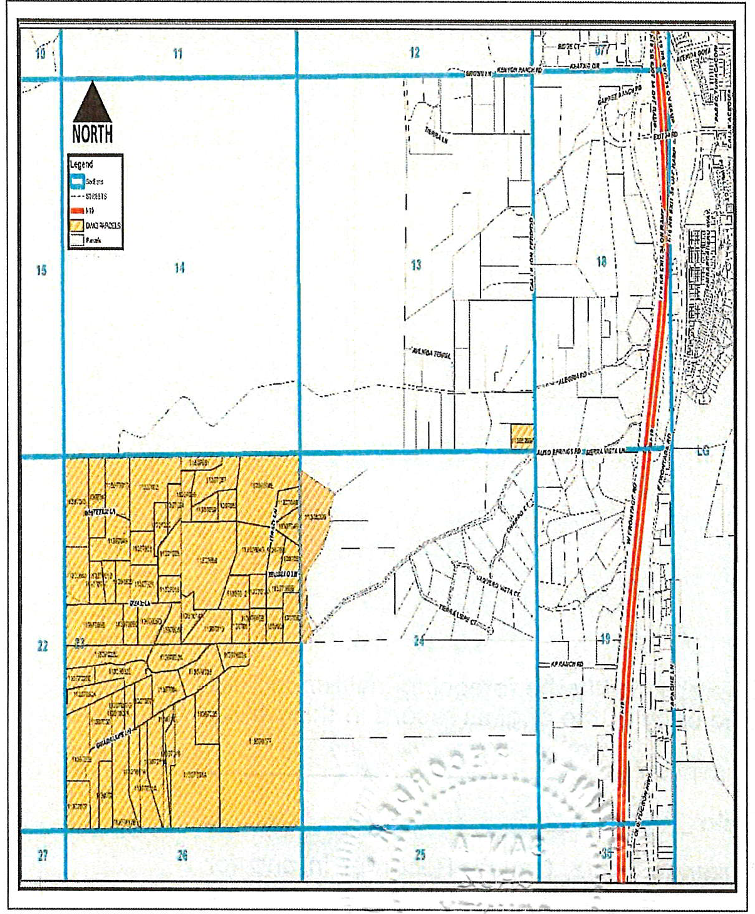

Slide 5
Elections
3 Board members
Staggered terms by law
  1 member started with 2 year term
  2 members started with 4 year term
David reelected/appointed in 2022 for 4 years
John & Jackson reelected/appointed in 2024 for 4 years
FYI - 4 school districts, 4 fire districts, and 2 DWIDS avoided general election voting (and County charges) by not having challenges for open seats – just minimum signatures

Slide 7
Loans
Initial request, $265,000 of which $220,000 forgivable
  Engineer said too little
  TTDWID thought of increasing to $500,000
  Engineer said could be $1,000,000
  WIFA had calculated TTDWID could afford $700,000
Increased loan application and signed agreement for $700,000
  $370,000 forgivable, interest at 2.464%; $330,000 @ $2130.00/month
Response to bid request
  Only one response
  ~$1,700,000

Slide 8
Pipeline Update
Original Pipeline Design
  Fiber
  Pressure Tank coating
  Pressure Pump Redundancies
  Complete control system at 42 ASR and Trujillo Trail

Slide 9
Revised Pipeline Design
Last year’s meeting we said reduced project scope to meet $700K
Also reported it was out to bid 1/19/24 and that bids were due back and bid opening 2/20/24
Update - two bids received
  $1.3M
  $871K
Revised further and low bidder (KE&G) agreed to do pipeline (not full project) for $688K
TTDWID to install and pay for balance

Slide 10
Pipeline Project Update
Piping between yards at 42 ASR and Trujillo Trail took about 2 months
  Paid ~$619K to KE&G; still owe ~$69K (retainage) when they finish last actions
Owe WIFA ~$2.7K/month from billings
Obtained Approval of Construction from ADEQ in late September ‘24 which authorized use of the pipeline
Water transfers require coordination, manual effort, multiple hours
  Plan is to automate
  $32,573 spent to date from TTDWID funds
  $9,000 remaining to be spent

Slide 11
Trujillo Trail DWID
Transaction Report
May 1, 2024-January 20, 2025
 | Date | Num | Name | Memo/Description | Amount
1190 Capital Projects
 | 06/13/2024 | 2024-3059359 | Ed Stubbs | Pipeline Project- DURApulse communication module and AC general purpose drive- To be installed at the well yard located at 42 Aliso Springs Road- 10-year lifespan | 1,028.69
 | 06/13/2024 | 2024-3059359 | Ed Stubbs | Pipeline Project- Flowmeter- To be installed at the well yard located at 42 Aliso Springs Road- 10-year lifespan | 1,187.63
 | 06/13/2024 |  | David Luckadoo | VDF Control Panel Enclosure for 42 Aliso Springs- Reimbursement | 1,844.16
 | 06/26/2024 |  | David Luckadoo | Amazon reimbursement- circuit breakers, din rail and terminal blocks | 105.86
 | 07/17/2024 | PC-800119037 | Ed Stubbs | 5SV15GG4F60N Goulds Pump & Motor Combo e-SV Stainless Steel Series Vertical Multi-Stage Pumps, CI-304Configuration with 1 1/4" Connection, 5 HP, 208-230/460 Volts, 60 Hz, 3 Ph (Three Phase), 3500 RPM, Viton® Shaft Seal.TEPE - Totally Enclosed Fan Cooled (Premium Efficient) Motor Enclosure, 15 Stages, 26 GPM Nominal Flow. | 3,624.27
 | 07/17/2024 | PC-800119037 | Ed Stubbs | Less overpayment from previous reimbursement because of shipping/taxes (the second one had less shipping/taxes-$73.04 than the first one- $80.97) (Flowmeter on 6/14/24) | -7.93
 | 08/12/2024 |  | David Luckadoo | Dana Kepner Company reimbursement for 2 new water meters | 976.20
 | 09/02/2024 |  | Ed Stubbs | Water level sensor for the tank at 42 | 81.57
 | 09/02/2024 |  | Ed Stubbs | Water level sensor for the tank(s) at TT. Only the last item on the invoice. | 60.61
 | 09/02/2024 |  | Ed Stubbs | Stainless fittings | 212.18
 | 09/02/2024 |  | Ed Stubbs | Instrument cables to connect the flow meter | 36.66
 | 09/02/2024 |  | Henson Excavation, LLC | 42 Well Yard and Trujillo Well Yard: Pipe fitting, concrete pads, pump installations, water lines | 17,320.00
 | 10/16/2024 |  | David Luckadoo | Reimbursement for pipeline project and for billing water meters | 4,992.25
 | 10/17/2024 |  | Ed Stubbs | Water depth sensor to be installed at TT. | 92.98
 | 12/03/2024 |  | Ed Stubbs | Water Liquid Level Sensor for use at TT yard | 72.65
 | 12/03/2024 |  | Ed Stubbs | DURApulse GS20 series AC general purpose drive for use at the TT yard | 945.54
Total for 1190 Capital Projects |  |  |  |  | $32,573.32

Slide 12
Lead and Copper and Drinking Water Quality and Rules
U.S. E.P.A. and thus AZDEQ required all water providers to review system and report
Required by Lead and Copper Rule in Safe Drinking Water Act
  System side piping composition to meter and piping composition from meter to house and report if known
  If not known, send advisories to customers implicated by not known status
Provided notices to 10 customers that we didn’t know composition from meter to house

Slide 13
Lead and Copper and Drinking Water Quality and Rules Cont’d
Drinking Water Quality and Current Rules (lead- Pb/ copper -Cu, PFAS, MAP testing, etc) Tutorial

Slide 14
Future Projects
Complete automation of well yards
AMI Water Meter replacements funded by a WIFA loan
Potential re-routing of pipeline from bottom of ASR by the wash up the hill to Guadalupe
  UES might re-route their powerline from ASR/Guadalupe intersection
  TTDWID has a valve ASR/Guadalupe already into which water pipe could attach and run west
    Same trench as UES would make sense

Slide 15
Yard Cleanup
Focus on Echo Canyon Yard
  Old red shed needs removal
  Conex (container) full of old equipment and fittings
  Old piping along fence
  Other things
February 8; 10:00
Big’ish dump trailer will be there
Volunteers needed

Slide 16
Backup

Slide 17
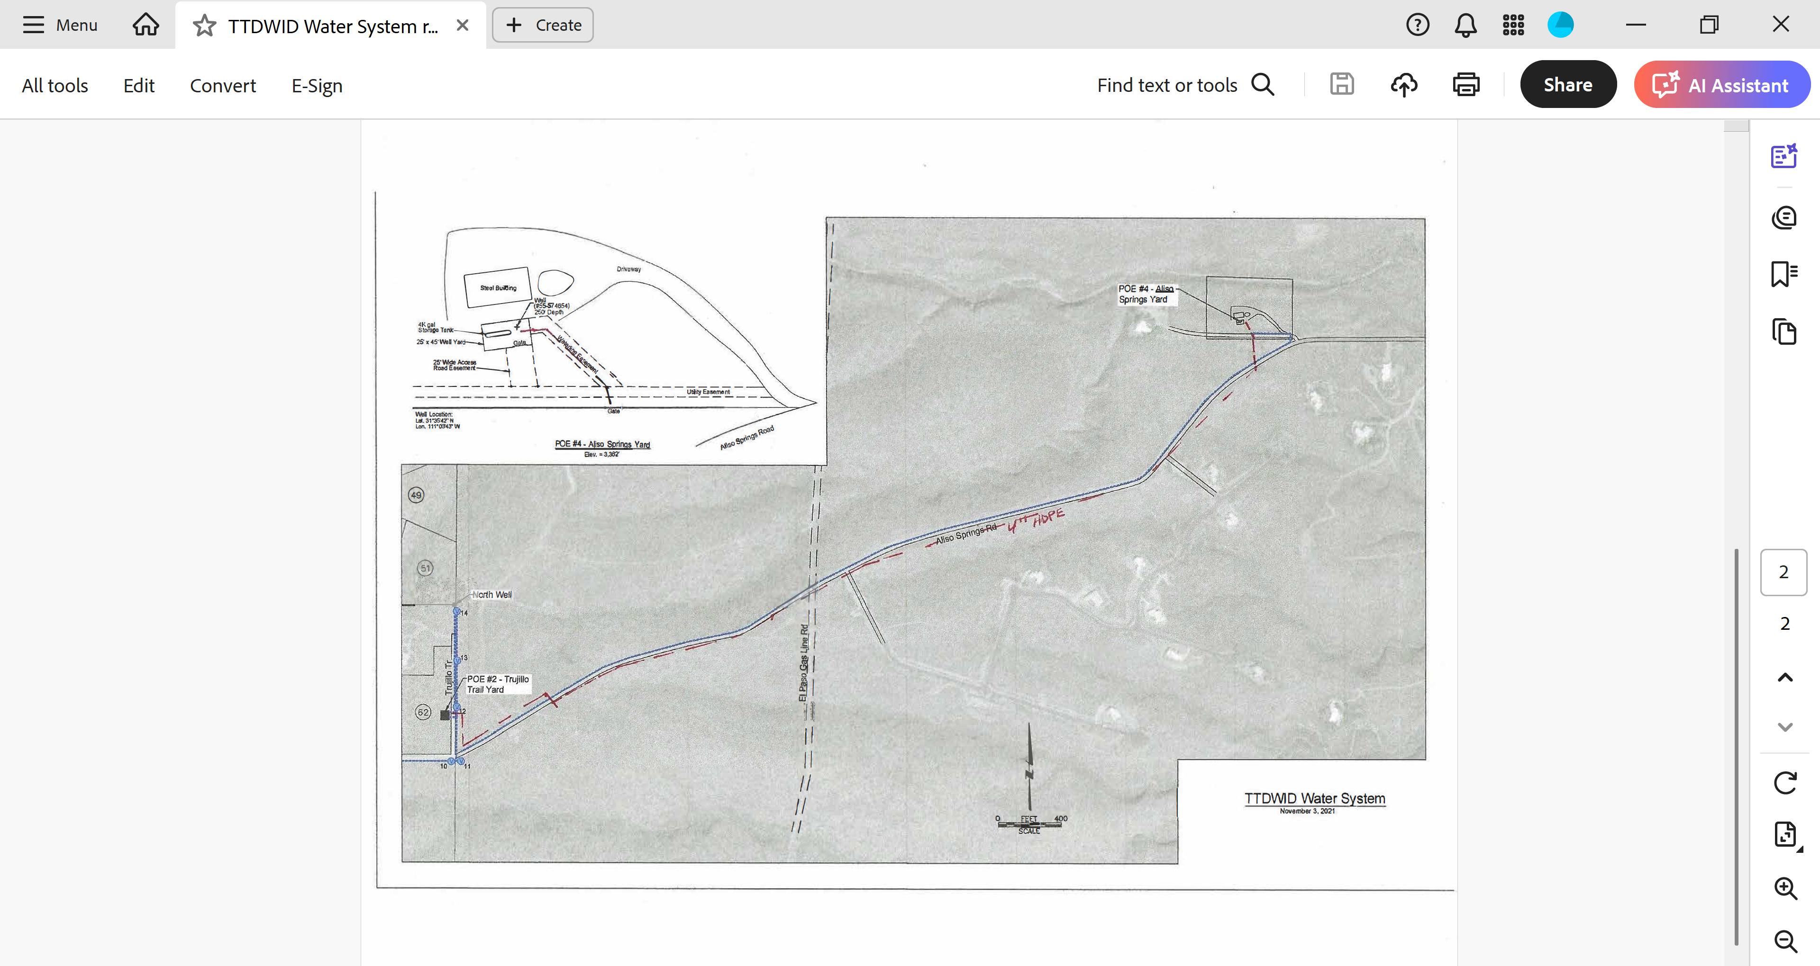

Slide 18
